Slide 1
Thank you for downloading!
Hope it helps with your presentations!
In case the embedded fonts don’t work, here are the download links:
Michroma
https://fonts.google.com/specimen/Michroma
Pattaya
https://fonts.google.com/specimen/Pattaya

Slide 2
SEVENTEEN
How to use semicolons
SEVENTEEN PowerPoint
Semicolon
; [@dstoryco]

Slide 3

SEVENTEEN
How to use semicolons
SEVENTEEN PowerPoint
Semicolon
; [@dstoryco]

Slide 4

Definition
SEMICOLON
semi • co • lon • noun
A semicolon is used when the author could’ve chosen to end their sentence but didn’t.
You are the author. Your story isn’t over yet.

Slide 5
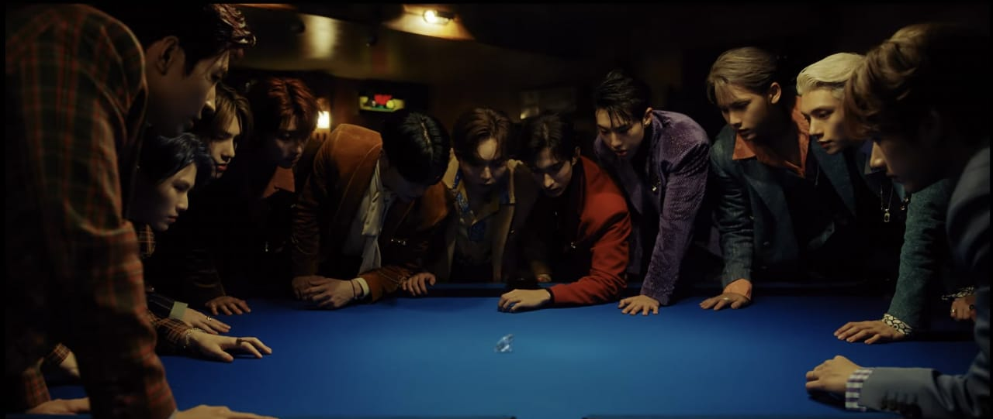
Stronger than a comma, but less final than a period.

Slide 6

How to use semicolons
r
u
1
l
e

Slide 7


RULE 1
Semicolons should only connect clauses that are related
How to use semicolons

Slide 8

How to use semicolons
r
u
2
l
e

Slide 9
RULE 2
Don’t add a semicolon before a conjunction (e.g. ”and”, “but”, “for”, “or”, “so”, “yet”)

Slide 10

Minggyu habitually cleans and organises they call him the “dorm cleaning fairy”
EXAMPLE

Slide 11
Thank You
Thank You
Thank You
Thank You
Thank You
Thank You
Thank You
Thank You
Thank You
Thank You
Thank You
Thank You
Thank You

